Slide 1

Lecture
on
“CBNST LAB –PMA-402”
by
Akansha Gupta
DEPARTMENT OF COMPUTER SCIENCE AND ENGINEERING
GRAPHIC ERA DEEMED TO BE UNIVERSITY

Slide 2
TRAPEZOIDAL METHOD

Slide 3
Trapezoidal Method
Trapezoidal Rule also referred to as Trapezoid Rule or Trapezium Rule is a method to find an approximate value of the integral of a given polynomial or function in a given interval. In simple terms, it is a method to evaluate a definite integral.
Trapezoidal method is based on the principle that the area under the curve which is to be calculated is divided into number of small segments. The bounding curve in the segment is considered to be a straight line as a result the small enclosed area becomes a trapezium.
The area of each small trapezium is calculated and summed up i.e. integrated.

Slide 4
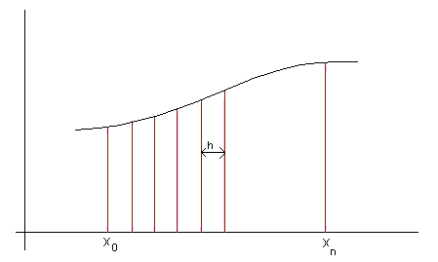
Contd…..
Let us consider a function f(x) representing a curve as shown in above figure. You are to find out the area under the curve from point ‘a’ to ‘b’. In order to do so, divide the distance between ab into a number vertical strips of width ‘h’ so that each strip can be considered as trapezium.

Slide 5
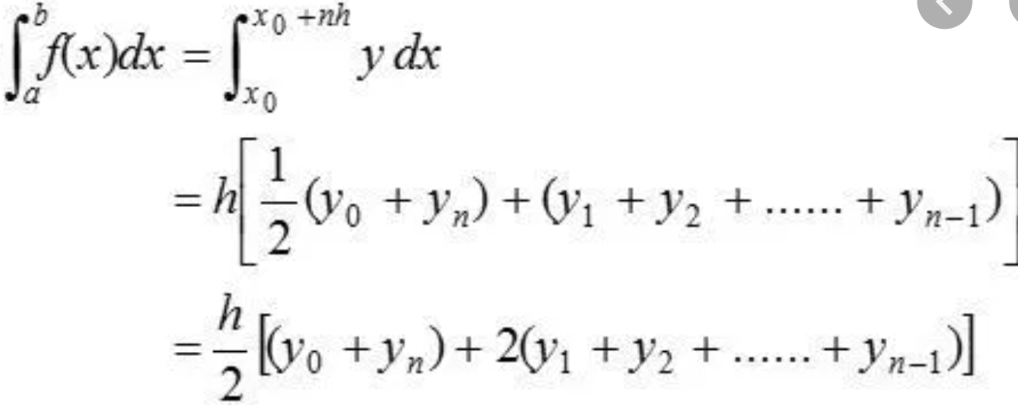
Trapezoidal Method Formula

Slide 6
Trapezoidal Method Algorithm
Step 1: Define Function f(x)
Step 2: Read n // number of observation
Read ul // upper limit
Read ll // lower limit
Step 3: Calculate step size
h = (ul-ll)/n;
Step 4: For i = 0 to n (step 1)
a[i]= f(i)
End For
Step 5: Display Observations say X and Y

Slide 7
Contd….
Step 6: Perform the required calculations
sum = 0
s1 = a[0] + a[n] // First and Last value
For i = 1 to n-1 (step 1)
sum = sum + a[i] // Sum of remaining values
End For
sum = sum * 2;
y = h * (s1 + sum) / 2;
Step 7: Print the desired value i.e. y

Slide 8
Pros & Cons
Pros:
Easy to implement
Cons:
Requires great number of iterations to be accurate, especially for big intervals (huge value of b – a)

Slide 9
THANKS
https://youtu.be/LlPS3x2WunU

